Slide 1
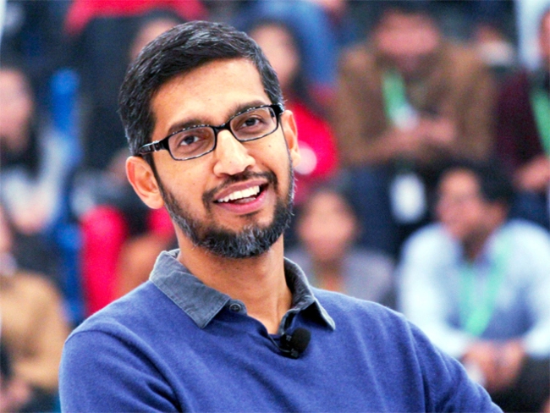

Sundar Pichai
Jukkalkar Syed Imtiaz
Shri Shivaji College, Chikhli
The Economic Times (google images)

Slide 2
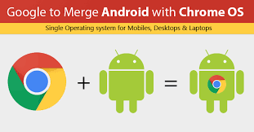
Sundar Pichai
Sunder Pichai is currently CEO of Google Inc.
(CEO: Chief Executive Officer)
He made the Chrome Browser a household name among internet users.
He contributed significantly to aligning Chrome with Android.
b. 12 July,1972, grew up in Madras (Chennai) in Tamil Nadu.
His mother, Laxmi Pichai was a stenographer.
(stenographer : a person whose job is to transcribe or write down the speeches of others for the sake of maintaining record)
His father, Regunathan Pichai was an electrical engineer.
google images

Slide 3
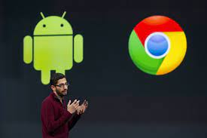
Google Chrome is a cross-platform web browser developed by Google. It was first released in 2008 for Microsoft Windows built with free software components.
Google images
Android is a mobile operating system based on a modified version of the Linux kernel and other open source software, designed primarily for touchscreen

Slide 4
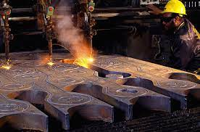
His father’s work ethic and and a constant exposure to technology inspired Sunder Pichai.
From a young age he excelled academically and was considered a bright student.
After his schooling, he joined IIT, Kharagpur and studied Metallurical Engineering.
Thereafter, he was granted admission to Stanford University in the US. He earned a Master’s degree in Engineering and Materials Science and later, a management degree from the Wharton School of Business.
Metallurgical engineering is the study of metals and how metals can be safely transformed into products that benefit humanity - things such as surgical implants, computer chips, cars, materials for space exploration, and more.
(https://www.sdsmt.edu.)
content. time.com

Slide 5
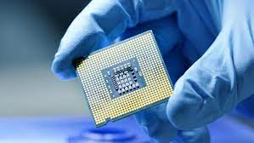
Initially, he worked at a company dealing with semiconductor devices called Applied Materials Inc.
And then as a management consultant for McKinsey & Co. He joined Google in 2004 as a manager for the Google Toolbar, later he took over as vice president of product management, and over saw research and development of consumer products such as iGoogle, Google Toolbar, Desktop Search and Gadgets, Google Pack and Gears.
Semiconductors are materials which have a conductivity between conductors (generally metals) and non-conductors or insulators (such as most ceramics). Semiconductors can be pure elements, such as silicon or germanium, or compounds such as gallium arsenide or cadmium selenide.

Slide 6
One of his former teachers at IIT at Kharagpur says, “He was doing work in the field of electronics at a time when no separate course on electronics existed in our curriculum. His thesis deals with implanting molecules of other elements in Silicon Wafers to alter its properties. It was very clear from the beginning that he was enthused about electronics and material.”

Slide 7
He is believed to have said that AI is “One of the most important things that humanity is working on. It’s more profound that, I don't know, electricity or fire.”
Artificial Intelligence is the simulation of human intelligence processes by machines, especially computer systems. Specific applications of AI include expert systems, natural language processing, speech recognition and machine vision.
(https://searchenterpriseai.techtarget.com/)
In 2011, he became senior vice president of Google Chrome and Apps, and was largely responsible for products including:
the chrome browser, an operating system, G-mail, Calender, Google Docs, and Google Drive. In 2016, he was appointed as the Chief Executive Officer(CEO) of Google Inc.
With its largest product, Google Assistant, it is clear that Google has now, actively embraced Artificial Intelligence(AI) technology and Pichai has been leading from the front in this area.

Slide 8
Google’s pervasiveness
Google’s pervasiveness has raised fears of a world monopolised and controlled by large corporates such as Apple, Facebook, Amazon, And Google. Recent concerns about data privacy on social media sites such as facebook and WhatsApp make it even more evident that unless customers consciously inform themselves and ask for control of their private data, corporations may use it for their own financial and political gain.
pervasiveness : the quality of being present everywhere.
monopolise: in business, to control something completely and to prevent other people having any effect on what happens

Slide 9
Technology, like all other tools need to be used with care
Technology, like all other tools need to be used with care, and the benefits balanced with risk. While it is unlikely that the world will revert to the pre-google world in the near future, innovation in technology seems to be working towards, making it simple to use without letting it intrude into our personal space.

Slide 10
In a blog that announced Sunder Pichai’s elevation as CEO of Google Inc, Larry Page said, “We have long believed that over time companies tend to get comfortable doing the same thing, just making incremental changes. But in the technology industry, where revolutionary ideas drive the next big growth areas, you need to a bit uncomfortable to stay relevant.”
Larry Page:
Lawrence Edward Page (born March 26, 1973) is an American business magnate, computer scientist and Internet entrepreneur. He is best known as one of the co-founders of Google.
(wikipedia)

Slide 11
Going by the steady innovations that Pichai seems to be leading in google, it is clear that Page’s advice is taken seriously by Pichai and others in technology business.

